Slide 1

School of Learning- UI

Slide 2
Module:
Content Version:
Duration:
Developed By:
Working with Components, Handling Data, Property, Event binding, Two Way data binding
1.0
Minutes
Sujal Ray

Slide 3

The Complete Angular Course

Slide 4

Training Objective
Learning Outcome
Understanding of Angular Fundamentals
Develop modern, complex, responsive and scalable web applications with Angular 12
Fully understand the architecture behind an Angular application and how to use it
Use the gained, deep understanding of the Angular concepts to quickly establish yourself as a frontend developer
Create single-page applications with one of the most modern JavaScript frameworks out there

Slide 5

Prerequisite
1.Install VScode
2.Install latest version of nodeJS
3.Angular CLI
4.Install Chrome.
5.Install GIT and create account on Bitbucket.

Slide 6
Course Outline
1.Working with Components
Creating component through CLI
Integrating templates and styles to component
Understanding on component selector
2.Handling Data, Property, Event binding, Two Way data binding
How to implement Data binding & string interpolation
How to implement Property binding
Event Binding
Two Way Data binding
3.Assignment

Slide 7

Working with Components

Slide 8
Creating component through CLI
Use Angular CLI to generate a new component name “products-list”
ng generate component component-name
The command scaffolds the following:
Creates a directory src/app/products-list.
Inside that directory four files are generated:
A CSS file for the component styles.
An HTML file for the component template.
A TypeScript file with a component class named ProductsListComponent.
A test file for the ProductsDetailComponent class.
The command also adds the ProductsDetailComponent as a declaration in the @NgModule decorator of the src/app/app.module.ts file.
In case if test cases are not required for the project use following command to generate component that will generate component without spec.ts file
ng g c component-name --skipTests

Slide 9
Integrating templates and styles to component
Templates in component
A template looks like regular HTML, except that it also contains Angular template syntax, which alters the HTML based on your app's logic and the state of app and DOM data.
Inline template –
Using Inline template, we can define HTML code in the typescript code.
For this we have to change templateUrl to template in component.ts file
Replace templateUrl: './products-list.component.html’
To template: '<app-product></app-product>’,
To Implement multiline code in template, replace single code into backticks
template: `<app-product></app-product>
<app-product></app-product> `,

Slide 10
Integrating templates and styles to component
Styles in component
Angular applications are styled with standard CSS. That means you can apply everything you know about CSS stylesheets, selectors, rules, and media queries directly to Angular applications.
Additionally, Angular can bundle component styles with components, enabling a more modular design than regular stylesheets.
Inline style –
Using Inline style, we can define CSS style in the typescript code.
For this we have to change styleUrls to styles in component.ts file
Replace styleUrls : ['./products-list.component.css']
To styles: [`h3{color:red}`],

Slide 11
Understanding on component selector
Till now we have seen element and css selector that means if we are using<h3> selector then we can directly use it through css and Element selector ie. <app-product-list> we can directly use it from selector and HTML.
Now there is another type of selector ie. Attribute selector.
The selector created will be of attribute type in products-list.component.ts,
selector: '[app-products-list]’,
To use this in HTML, We have to write :
<div app-products-list></div> in app.component.html where app-products-list is attribute selector
Selector by class
selector: '.app-products-list’, in products-list.component.ts
<div class="app-products-list"></div>
To use .app-product-list class selector we can directly write name of class selector in app.component.html as class=“app-products-list”
Note: selector by ID is not supported using Angular

Slide 12
Handling Data, Property Binding, Event Binding, Two way Data Binding

Slide 13
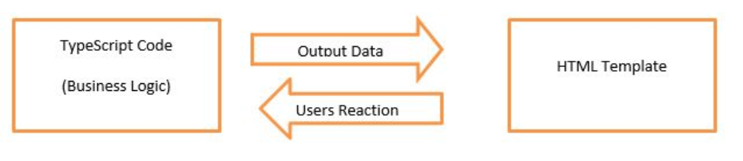
Implementing Data binding & string interpolation
Data Binding
Data binding is the core concept of Angular and used to define the communication between a component and the DOM. It is a technique to link your data to your view layer. In simple words, you can say that data binding is a communication between your typescript code of your component and your template which user sees. It makes easy to define interactive applications without worrying about pushing and pulling data.
Data binding can be either one-way data binding or two-way data binding.
String Interpolation {{data}}
Property binding [property]=“data”
Event Binding (event) = “expression”
Combination of both is two way data binding [(ngModel)] = “data”

Slide 14
Implementing Data binding & string interpolation
One-way databinding
One way databinding is a simple one-way communication where HTML template is changed when we make changes in TypeScript code.
In one-way databinding, the value of the Model is used in the View (HTML page) but you can't update Model from the View. Angular Interpolation / String Interpolation, Property Binding, and Event Binding are the example of one-way databinding.
Two-way databinding
In two-way databinding, automatic synchronization of data happens between the Model and the View. Here, change is reflected in both components. Whenever you make changes in the Model, it will be reflected in the View and when you make changes in View, it will be reflected in Model.
This happens immediately and automatically, ensures that the HTML template and the TypeScript code are always updated.

Slide 15
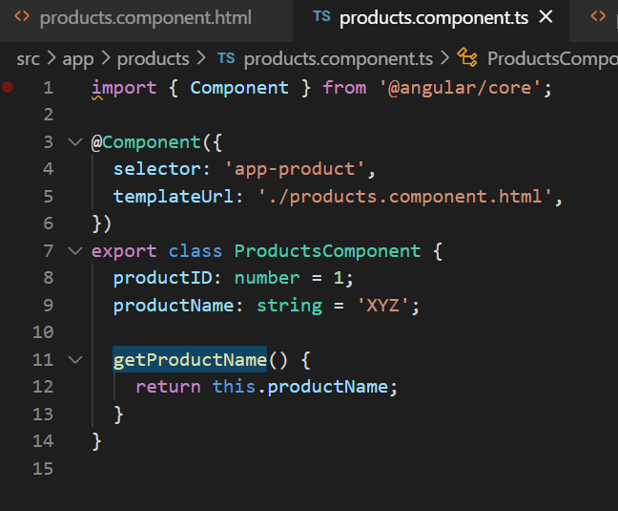
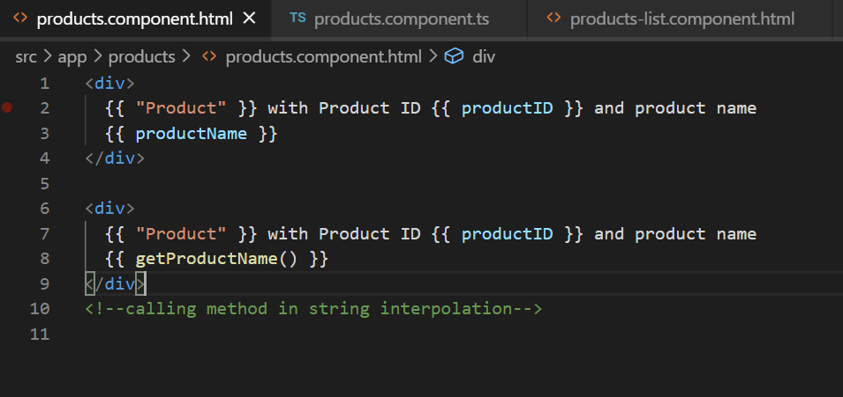
String interpolation
String Interpolation is a one-way databinding technique which is used to output the data from a TypeScript code to HTML template (view). It uses the template expression in double curly braces to display the data from the component to the view.
For example:
{{ data }}
String interpolation adds the value of a property from the component:

Slide 16
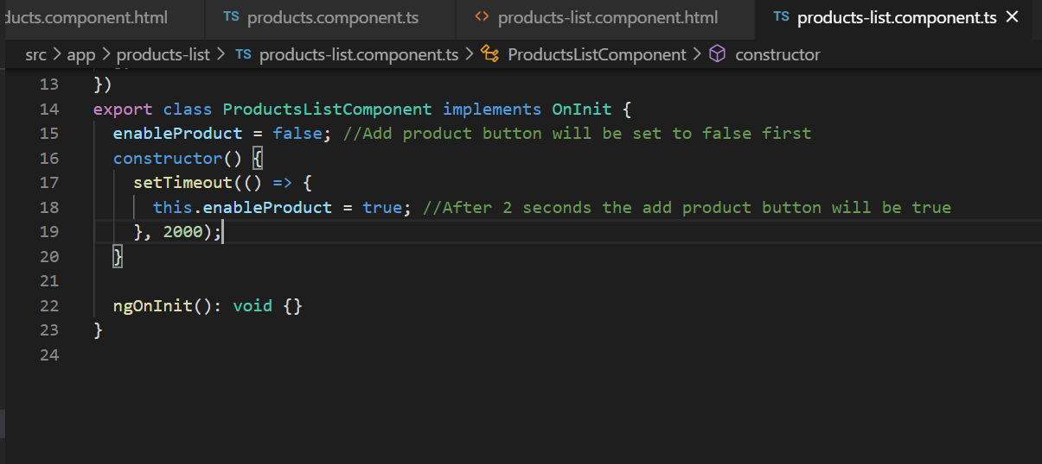
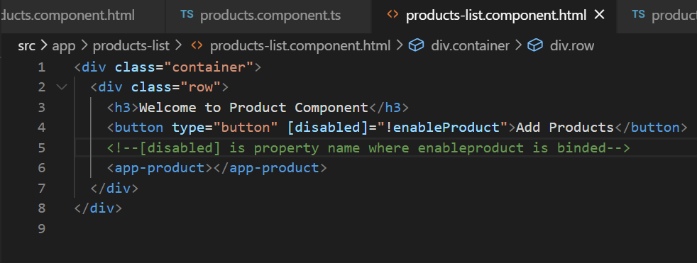
How to implement Property binding
Property Binding is also a one-way data binding technique. In property binding, we bind a property of a DOM element to a field which is a defined property in our component TypeScript code.

Slide 17
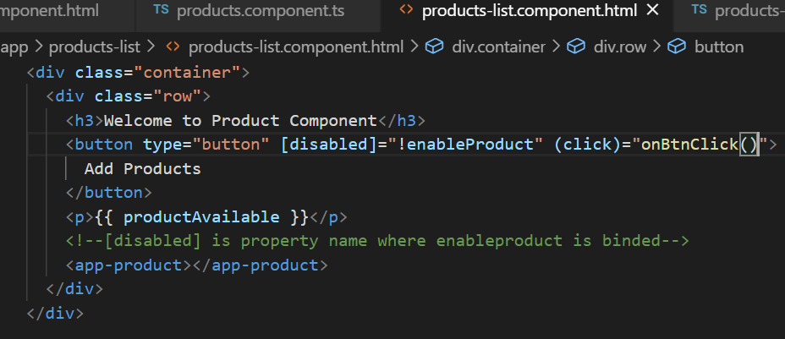
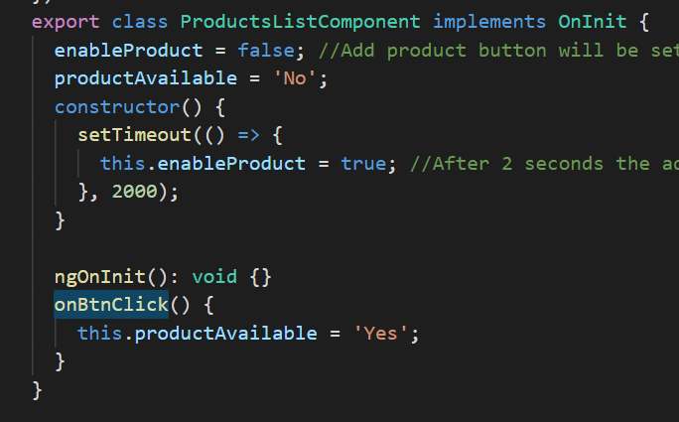
Event Binding
In Angular, event binding is used to handle the events raised from the DOM like button click, mouse move etc. When the DOM event happens (eg. click, change, keyup), it calls the specified method in the component. In the following example, the cookBacon() method from the component is called when the button is clicked:
For example:
<button (click)=“clickMe()"></button>

Slide 18
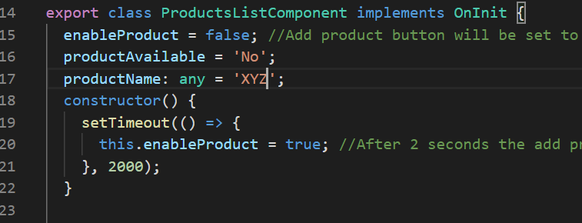
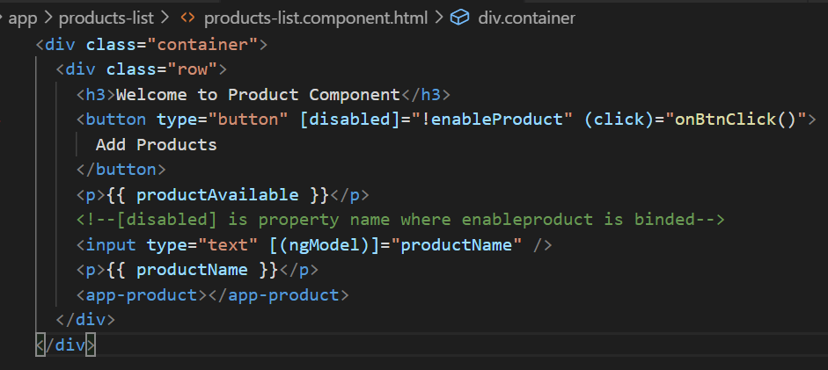
Two Way Data binding
We have seen that in one-way data binding any change in the template (view) were not be reflected in the component TypeScript code. To resolve this problem, Angular provides two-way data binding. The two-way binding has a feature to update data from component to view and vice-versa.
In two-way data binding, property binding and event binding are combined together.
Syntax:
[(ngModel)] = "[property of your component]"

Slide 19
Assignment

Slide 20

Assignment – Part1
Create two new component using Angular CLI named “success” and “failure” without spec.ts file.
2. The template & CSS for success component will be used externally.
3. The template & CSS for failure component will be used internally.
4. The selector for failure will be attribute selector.
5. Keep success component on top and failure after success.
6. Style Success with Green Color with external style & failure with red Color with inline styling.
Output will be like:

Slide 21
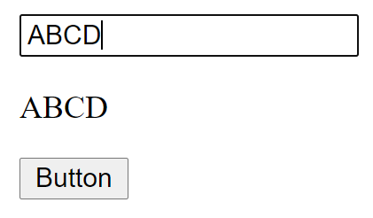
Assignment – Part2
Create input field that will update property ‘companyName’ with two way data binding
Display companyName inside p tag with string interpolation
Create a button as label ‘Button’ that will be enabled only if companyName is not empty
On click of button change companyName with ‘XYZ company’

Slide 22
Knowledge Check – Quiz Time
Question Description
Option#1 Option#2 Answer#3 Option#4
Question Description
True False
Question Description
Fill ______ the Blank?
Question Description (Match The Following)

Slide 23
THANK YOU
YASH University | academy@yash.com
YASH Learning & Development
Notes:
https://www.freepik.com/free-photo/copy-space-friends-holding-air-chat-bubble_5966192.htm#page=1&query=chat&position=47

